Slide 1
The LionWeb Initiative
at LangDev 2023
Jos Warmer, Niko Stotz

Slide 2
Project Overview

Slide 3
Mission
To create an ecosystem of interoperable components for building language-oriented modeling tools on the web.
Adopt language engineering
Reduce vendor lock-in
Mix and match components
Foster innovation and incremental improvements

Slide 4
Why – Rationale
Most mature LWBs desktop-based
Long history
Everything needs to be web
Huge re-engineering effort
Don’t re-invent the wheel for each LWB
Focus on strengths, reuse other parts
Shared effort & multiple providers
better commercial acceptance

Slide 5
How – Principles
LionWeb as boring, reliable base
Innovate on top
Everything is a model
Markus Voelter’s Whitepaper “A Platform for Systems and Business Modeling”
Rough consensus and running code
Adopt IEEE approach
Business-friendly Open Source
Apache 2.0 license

Slide 6
How – Activities
Primary: define protocols
meta-metamodel
reference architecture
Secondary: programming language APIs
reference implementations
Also: collaboration hub for components

Slide 7


What – Work Products
communication protocol specifications
+ meta-metamodel
reference architecture for cloud-based modeling tools
bindings in several programming languages
reference implementations and examples
Priority

Slide 8











What not – Out of Scope
Yet another Language Workbench
Plug-and-play component system
Deployment scheme

Slide 9
What not – Out of Scope
Yet another Language Workbench
Plug-and-play component system
Deployment scheme

Slide 10
Who – Participation
Meinte Boersma, Freelancer, The Netherlands
Norman Koester, itemis (modelix Team), Germany
Sergej Koscejev, Freelancer, Czech Republic
Sascha Lisson, itemis (modelix Team), Germany
Eugen Schindler, Canon Production Printing, The Netherlands
Alex Shatalin, Jetbrains (MPS Team), Czech Republic
Niko Stotz, F1RE, The Netherlands
Federico Tomassetti, Strumenta, Italy
Markus Voelter, Freelancer, Germany
Jos Warmer, openmodeling (Freon Team), The Netherlands
⇨ And you?

Slide 11
Where – Current Status
First release 2023.1 planned around November 2023
Serialization format, meta-metamodel
APIs
Java, JavaScript, MPS, (C#)
Integrations
EMF, Freon, Kotlin, MPS, *Lasu

Slide 12
Technical Overview

Slide 13
Reference Architecture
1
2

Slide 14
Reference Architecture: Parts
B
C
A
G
1
D
2
F
E
Repository
Model
Original
Derived
Client
Editor
Processor
Model checker
Importer
Generator
A
B
F
G
C
D
E

Slide 15
Reference Architecture: Protocols
1
5
2
4
3
Bulk
Load model, modify, store it back
Load, derive something else
Delta
Initialise with model, get notified of changes, write back changes continuously
2
5
1
4
3

Slide 16
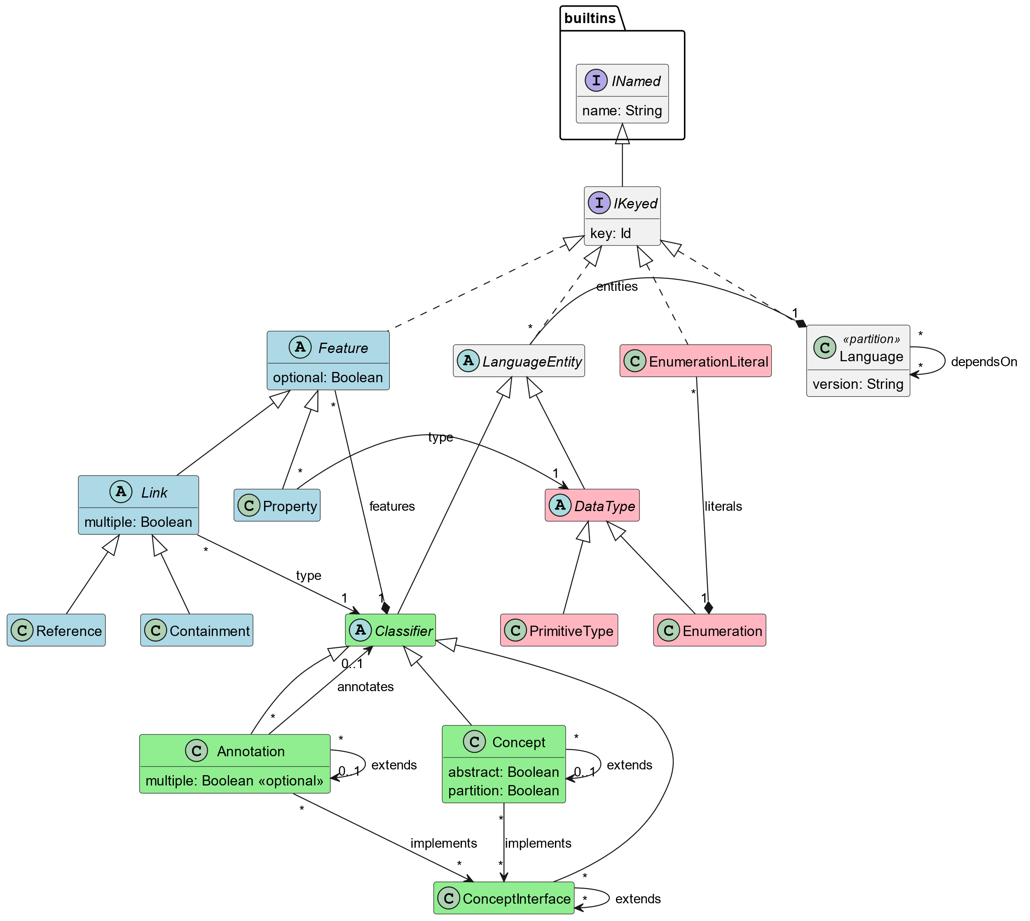
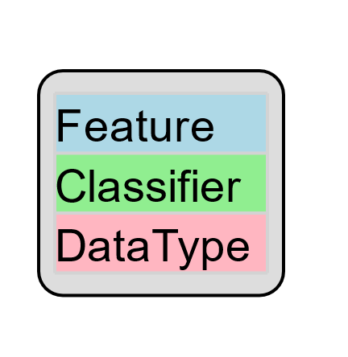
Meta-Metamodel

Slide 17
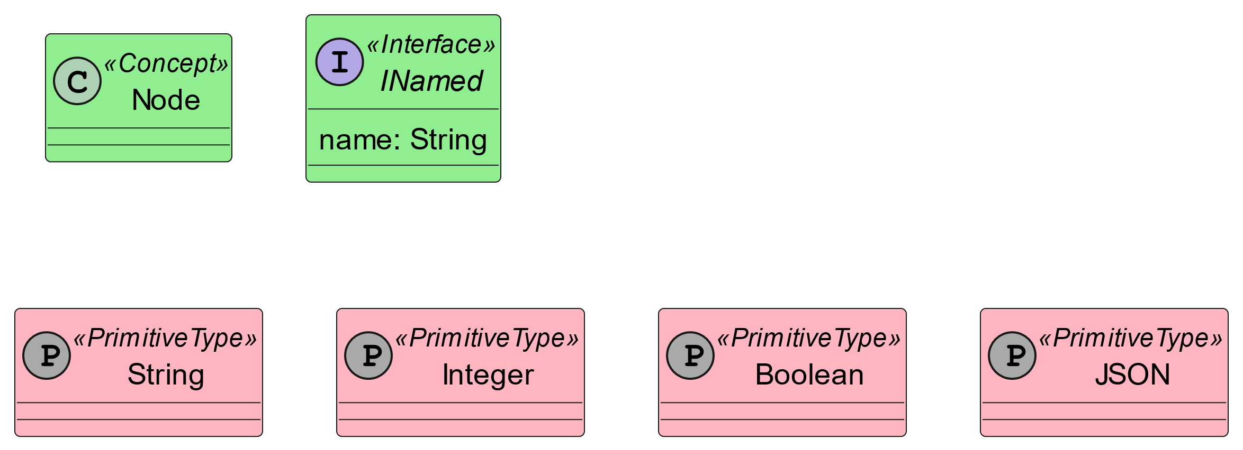
Built-in Standard Library

Slide 18
Leftovers

Slide 19
Demo Contents
Generate LIonWeb metamodel from Kotlin classes
Parse properties file and store as LIonWeb instance model
Import metamodel into MPS
Convert to MPS languages
Import properties instance model into MPS
Show instance model in Freon web editor, served from MPS via LIonWeb protocol
Change some values in Freon
Store changes back to MPS
Export example instance from MPS to LIonWeb
Unparse example instance

Slide 20


Near Term Focus
Finalize Bulk Protocols and document them
Start Work on delta protocols / collaboration
Refine meta-metamodel
Improve reference implementations and examples
Support integration with more tools
If you want to join and work with us, talk to any of the current members.
Or contact us all: info@lionweb.io
If you just want to stay in touch and use our stuff, please join our Slack:
https://join.slack.com/t/lionweb/shared_invite/zt-1uvaly9eb-z529c694OIN5oBh9FH1vhQ

